Slide 1
Analysis Results: Smart Fellow
By Tevin Gathemia Gatheru

Slide 2
Hypothesis
Cybersecurity roles earn the highest salary

Slide 3
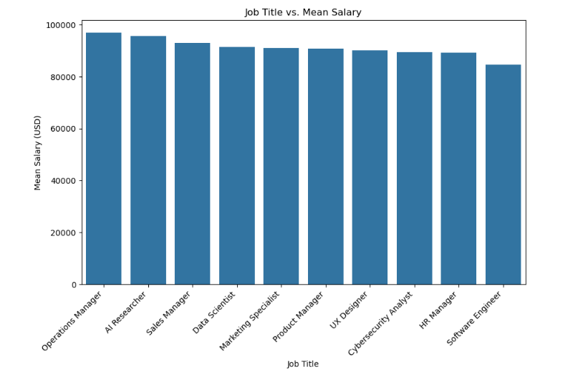
Key Findings
Number of columns: 10
Rows: 500

Slide 4
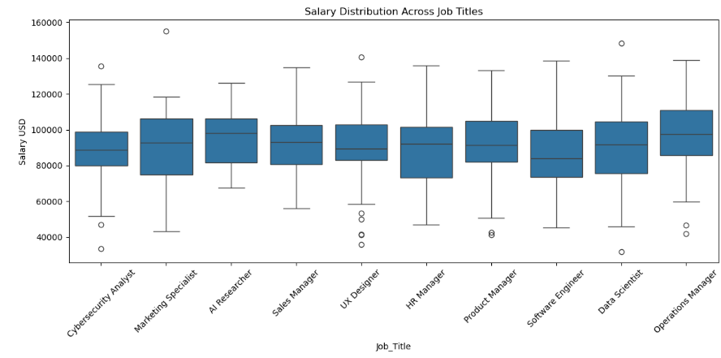

Slide 5
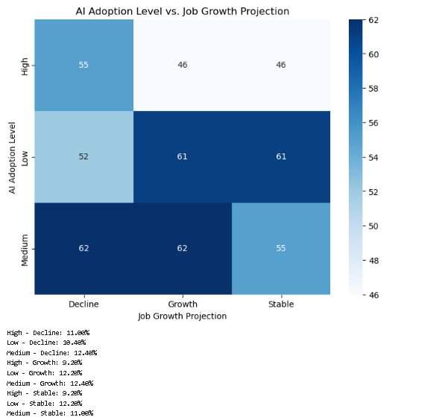
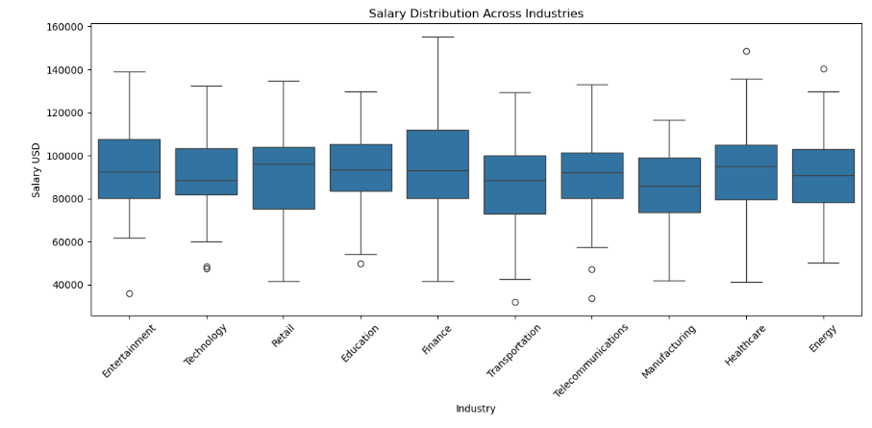
Trends

Slide 6
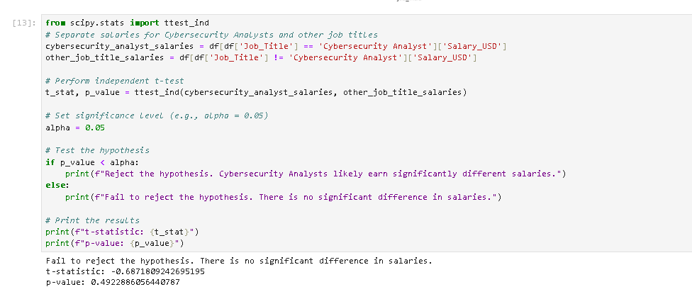
Conclusions
The hypothesis is not verified to be true, this is because the highest paid job title is the Operations Manager

Slide 7
The End

